Slide 1

Scheduling Jobs on a Supercomputer

Slide 2









Meet the User Support Team
Layla Freeborn
Brandon Reyes
Andy Monaghan
Michael Schneider
John
Reiland
Dylan Gottlieb
Mohal Khandelwal
Ragan
Lee
2

Slide 3

Website: www.rc.colorado.edu
Documentation: https://curc.readthedocs.io
Helpdesk: rc-help@colorado.edu
3

Slide 4

https://github.com/ResearchComputing/scheduling_a_job_on_a_supercomputer_rc_shortcourse

Slide 5
Session Overview
Overview of Jobs Submissions
Interactive Jobs
Job Directives
Batch Jobs
Checking/monitoring jobs

Slide 6
Remember, when you login to the HPC system you are put on a login node. You need to then gain access to a compute node to run software.

Slide 7

General Overview of Job Submission
Computer
Hardware
Submit Job
Management
service
Get Results
Storage

Slide 8

SLURM – Job Scheduler
Simple Linux Utility for Resource Management
Allocates compute resources to users through Jobs
2 Types of Jobs
Batch Jobs
Interactive Jobs
Notes:
Because our clusters are shared resources with many users trying to utilize available compute with their applications, we need a system to divide compute in a simple and fair system

Slide 9

Batch vs Interactive
Batch
Job
Interactive
Job

Slide 10
Batch vs Interactive
Runs a job script
No need for user input
Best for tested workflows and long/big jobs
Batch
Job
Interactive
Job

Slide 11
Batch vs Interactive
Runs a job script
No need for user input
Best for tested workflows and long/big jobs
Requires active user input
Terminal or GUI
Best for development and exploration
Batch
Job
Interactive
Job

Slide 12
Interactive jobs
acompile
Quick access to resources
Limit of 4 CPUs for up to 12 hours
Focused on compiling/building software and small workflows
sinteractive
Request any partition, more resources, and longer walltime
Subject to standard wait times (not immediate access)
Focused on GUI-based software

Slide 13
Running an interactive job
Here we will run a Python script using an interactive job
First request resources:
When the job starts you will be put on a compute node and you can execute your commands:
To quit:
$ sinteractive --partition=atesting --qos=testing --time=00:10:00 --ntasks=1
$ module load anaconda
$ python my_very_cool_script.py
$ exit

Slide 14
Common directives
Partition – A collection of compute nodes
--partition=<partition_name>
Quality of service (QoS) – System defined constraints for a job (more on this later!)
--qos=<qos>
Allocation – Account to “charge to”
--account=<account_name>
Number of nodes to run on
--nodes=<nodes>
Number of cores to run on
--ntasks=<number-of-tasks>

Slide 15
Common directives
Wall time – How long you want to run on these resources
--time=<wall time>
Job name
--job-name=<jobname>
Output – Where all output that would be written to the terminal should go
--output=<name>
Send an email when events happen in the job
--mail-type=<type>
Email address to send updates to
--mail-user=<user>

Slide 16
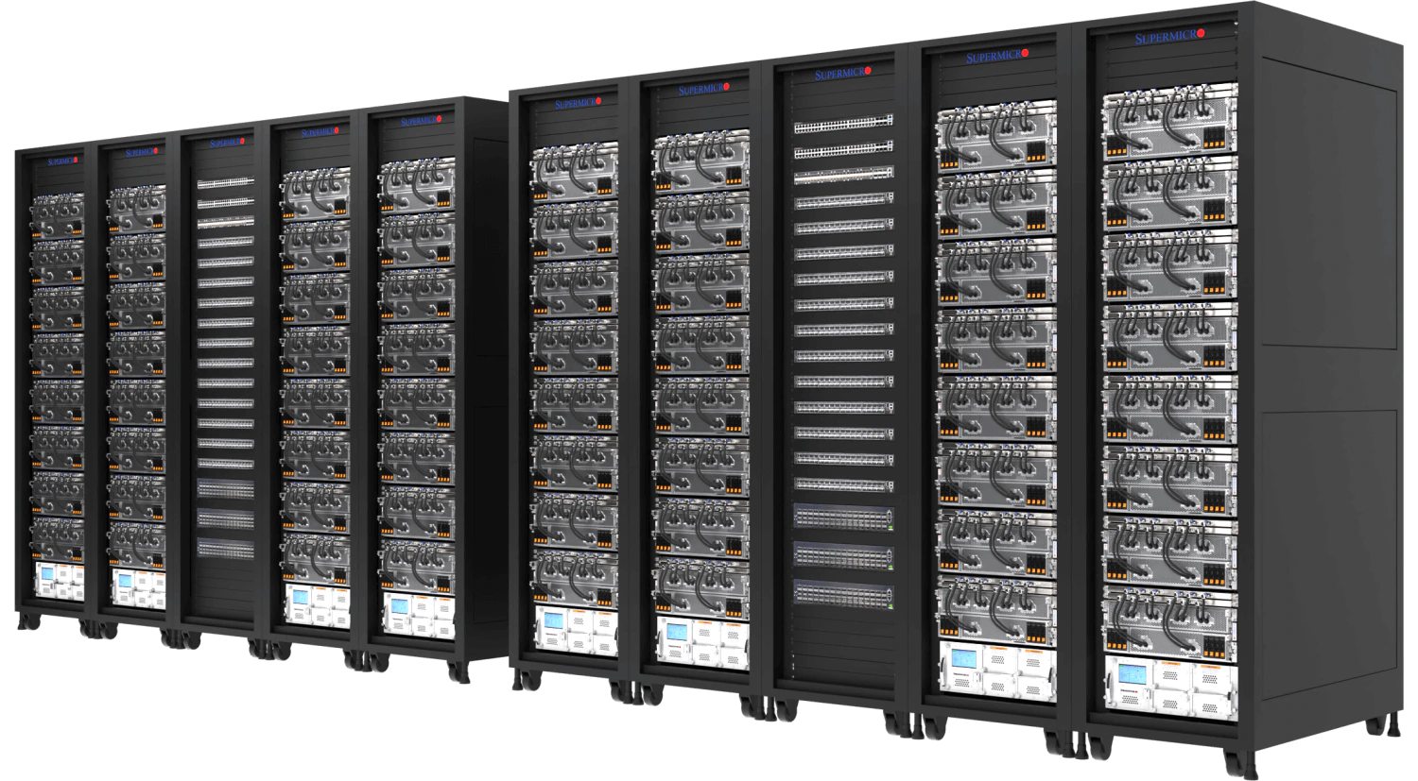

Alpine Partitions
COMPUTE
Notes:
Compute nodes are organized into partitions – logical groups of similarly spec’d hardware.
Partitions make it easier to request specific resources and ensure a more consistent user experience.
The Alpine Cluster has four primary partitions.
Detailed Information on Alpine Hardware: https://curc.readthedocs.io/en/latest/clusters/alpine/alpine-hardware.html

Slide 17
Alpine Partitions
amilan
General Usage
Notes:
amilan:
285 Nodes
64 CPU Cores per Node
3.75 GB of RAM per CPU (240 GB total)
Detailed Information on Alpine Hardware: https://curc.readthedocs.io/en/latest/clusters/alpine/alpine-hardware.html

Slide 18
Alpine Partitions
amilan
General Usage
amem
High Memory
Notes:
amem:
22 Nodes
48 CPU Cores per node (12)
64 CPU Cores per node (10)
21.5 GB of RAM per CPU (1 TB total)
Detailed Information on Alpine Hardware: https://curc.readthedocs.io/en/latest/clusters/alpine/alpine-hardware.html

Slide 19
Alpine Partitions
amilan
General Usage
aa100
Nvidia GPU’s
amem
High Memory
Notes:
aa100
12 Nodes
64 CPU Cores per Node
3.75 GB of RAM per CPU (240 GB total)
3 GPU’s per Node (Nvidia A100)

Slide 20
Alpine Partitions
amilan
General Usage
aa100
Nvidia GPU’s
amem
High Memory
ami100
AMD GPU’s
Notes:
ami100
8 Nodes
64 CPU Cores per Node
3.75 GB of RAM per CPU (240 GB total)
3 GPU’s per Node (AMD MI100)
Detailed Information on Alpine Hardware: https://curc.readthedocs.io/en/latest/clusters/alpine/alpine-hardware.html

Slide 21
Quality of Service (QoS)
QoS | Description | Max wall time | Max jobs/user | Max nodes/user
normal | Default QoS | 24 H | 1000 | 128
long | For jobs needing longer wall times | 7 D | 200 | 20
mem | High-memory jobs | 7 D | n/a | 12
testing | For jobs submitted to testing partitions | 1 H | 1 | n/a

Slide 22
Batch Jobs
Batch Jobs are jobs you submit to the scheduler that are run later without supervision
A job script is simply a script that includes SLURM directives (resource specifics) ahead of any commands.

Slide 23
Anatomy of a job script
#!/bin/bash
## Directives
#SBATCH --<option>=<value>
## Software
module load <software>
## User scripting
<command>

Slide 24
Anatomy of a job script
#!/bin/bash
## Directives
#SBATCH --<option>=<value>
## Software
module load <software>
## User scripting
<command>

Slide 25
Directives in a job script
#SBATCH --<option>=<value>

Slide 26
Example job script
#!/bin/bash
## Directives
#SBATCH --ntasks=1 # Number of requested tasks/cores
#SBATCH --time=0:01:00 # Max run time
#SBATCH --partition=amilan # Specify Alpine CPU node
#SBATCH --output=test_%j.out # Rename standard output file
## Software
module purge # Purge all existing modules
## User commands
echo "This is a test of user $USER"
Notes:
Output files are important for debugging and verifying a job has completed successfully. Always include a --output directive!
The output file is created in directory job was run unless specified in your --output directive.
If the directive --output is not provided, then a generic file name will be used (slurm_xxxxxx.out).

Slide 27
Software job script example
#!/bin/bash
## Directives
#SBATCH --ntasks=1 # Number of requested tasks/cores
#SBATCH --time=0:01:00 # Max run time
#SBATCH --partition=amilan # Specify Alpine CPU node
#SBATCH --output=test_%j.out # Rename standard output file
## Software
module purge # Purge all existing modules
module load anaconda # Load Anaconda
conda activate <my-conda-environment> # Activate CONDA environment
## Run Python script
python my_cool_script.py
Notes:
Software can be loaded using the software module system or by accessing user installed software in their /projects directory.
https://curc.readthedocs.io/en/latest/compute/modules.html
Be careful not to run GUI or other software that requires user interaction!

Slide 28
Submitting a Job script
sbatch <job_file> <other-directives>
Command to submit a job to the SLURM job scheduler

Slide 29
Submitting a Job script
sbatch <job_file> <other-directives>
Command to submit a job to the SLURM job scheduler
If we created the job script “my_first_job.sh” then we would submit it as follows:
sbatch /path/to/my_first_job.sh

Slide 30
Submitting a Job script
sbatch <job_file> <other-directives>
Command to submit a job to the SLURM job scheduler
If we created the job script “my_first_job.sh” then we would submit it as follows:
sbatch /path/to/my_first_job.sh
Modify slurm directives in the batch script:
sbatch /path/to/my_first_job.sh --ntasks=12

Slide 31
Checking your jobs
squeue: Monitor your jobs status in queue and while running:
By default, shows all jobs in queue can specify using:
sacct: Check back on usage statistics of previous Jobs
By default, only checks all jobs from the start of the current day can specify using:
$ squeue –u <username>
$ squeue –p <partition>
$ sacct –u <username>
$ sacct --start=MM/DD/YY –u <username>
$ sacct –j <job-id>

Slide 32
Checking your jobs
Another method of checking details of your job while running is with scontrol
Advanced command usually used by system administrators, but you can use it too!
To check the percentage of CPU and memory usage of a job after it completes, use seff
$ scontrol show job <job number>
$ module load slurmtools
$ seff <job number>

Slide 33
Thank you!
Documentation: curc.readthedocs.io/
Trainings with Center for Research Data and Digital Scholarship (CRDDS): https://www.colorado.edu/crdds/
Helpdesk: rc-help@colorado.edu
Consult Hours (Tuesday 12:00-1:00 in-person, Thursday 1:00-2:00 virtually)

Slide 34

Survey and feedback
https://tinyurl.com/curc-survey18

